Slide 1
COMM 2216
Technical Instructions

Slide 2

Readers have jobs to do
Your instructions will be judged by how well the reader can perform their tasks.

Slide 3
Readers have jobs to do
When writing instructions, keep the reader’s task in mind.
Don’t focus on the system. The reader is not interested in theoretical explanations.
How do I complete that specific task?

Slide 4
Study the Reader
What information are they likely to have already? Assume less.
Never overestimate what people know.
What information are they likely to need at the moment they pick up your instructions?

Slide 5
What is a procedure?
A procedure is “a sequence of clearly defined steps that result in the completion of a job task.”
The goal of a procedure is to enable users to complete a job task in an error-free manner.
Procedures are the most common type of information in a software manual.

Slide 6
Readers have jobs to do
Make it easy for the reader to:
Find the right procedure in the document (task-based headings)
Perform the actions correctly the first time (task-focused instructions)

Slide 7


System View
The Report Writer
Report Commander
Report Scheduler
Report Viewer
Task View
Scheduling Reports
Running Reports Immediately
Scheduling One-time Reports
Scheduling Periodic Reports
Viewing Reports

Slide 8
System view
Describes every menu in sequence
Explains the system
Task view
Organized according to related user tasks
Explains how to do specific tasks (not everything)

Slide 9
Writing style for procedures
Task-based heading
Numbered steps
Each step begins with a verb in the imperative (command) form
Each step should be a physical action (click, type, press, pull, etc.)

Slide 10
Example procedure
Brief intro to establish what and why
To run a computer security scan,
Click Start and choose McAfee Anti-Virus
Click Scan Now
Note: this may take several minutes to several hours, depending on your system. Do not turn off your machine.
Once the scan is complete, a lists of identified threats will appear.
Numbered steps begin with an active verb
Interface objects are formatted in bold
Notes and expected output are not numbered.

Slide 11
Structure of a Procedure
A procedure should include:
a procedure title
a brief introduction that identifies the real-world task purpose and its relevance
What are you about to do?
Why are you doing that?
Numbered steps
How to do it
Screenshots or visuals, as required

Slide 12
Writing Task Oriented Procedures
Careful task analysis precedes quality finished procedures.
Procedures should identify real-world, typical tasks that the user is likely to perform.
Procedures should follow typical scenarios, and include corresponding data and screenshots.
Aim to group related tasks into clusters of procedures.

Slide 13
Use Active Voice
The use of passive sentences is poor writing for software manuals.
The format command is used to change the font.
vs.
To change the font, click Format.
What/Why
How

Slide 14
Steps vs. Non-steps
Why are the following not steps?
File > Print
The print property sheet appears.
File Not Found

Slide 15
Conditional Steps
Conditional steps take the standard If (test), then (action), else (alternate action) form.
An example of a conditional step is:
If you can exit, simply restart the application. Otherwise, you may need to restart your computer.

Slide 16
Write Modular Procedures
Humans have an information processing limit of about 7 steps.
When faced with a long procedure, break it into a series of related procedures.
Similarly break up long steps into sub-steps.

Slide 17
Logical Order
Make sure your steps are in chronological order!
Put warnings before steps, not after!
Put what and why before how
Use numbered lists for ordered steps, and bulleted lists for options.

Slide 18
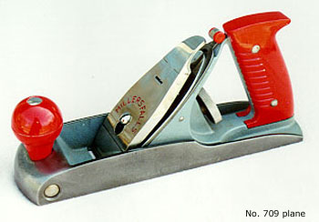
Use the correct order of adjectives.
Size
Shape
Colour
Material
Noun
Small round red plastic control knob

Slide 19
The Really Sad Part is …
If the instructions are well-written, the employee will usually take the credit for their efficiency.
Your instructions should be so clear as to make the procedure seem simple, even if it’s a complicated system.

Slide 20


Slide 21
In terms of tone …
Be encouraging.
Tell the reader when they’ve been successful.
Eg. Well done. You’ve successfully completed a system scan. Your computer is now threat-free.

Slide 22
Be consistent
To ensure good usability, consistently apply patterns of:
structure
style
voice
tone
spelling
presentation

Slide 23
Use Verbs Consistently
Select OK.
Enable the File Names check box.

Slide 24
Use verbs and nouns consistently
Select OK.
Enable the File Names check box.
Click OK
Click the File Names check-box

Slide 25
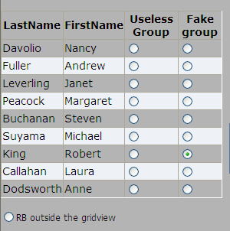
Use verbs and nouns consistently
Select the option?
Click the radio button?
Choose the option button?
Click the bubble?
Choose a standard name and stick with it.
Large organizations will have a Style Guide.

Slide 26
Microsoft Manual of Style
http://jasonhall.ca/wp-content/uploads/2015/08/Microsoft.Press_.Microsoft.Manual.of_.Style_.4th.Edition.Jan_.2012.pdf

